Slide 1
CHAPTER 7 the logic of sampling

Slide 2
A Brief History of Sampling
“President” Alf Landon (R)
Literary Digest poll, 1936
Two million ballots mailed to people listed in telephone directory and auto owners
Problems?
“President” Thomas E. Dewey
Gallup’s quota sampling
Problems?

Slide 3
What is Sampling?
Sampling
The process of selecting observations for your research
Nonprobability versus Probability Sampling

Slide 4
Nonprobability Sampling
Nonprobability Sampling
Selecting a sample without using methods based on probability theory
Available subjects
Purposive sampling
Snowball sampling
Quota sampling

Slide 5
Nonprobability Sampling
Available Subjects
Units selected based on convenience
No representativeness
Researchers must be very cautious about generalizing
When might this method be appropriate?

Slide 6
Nonprobability Sampling
Purposive or Judgmental Sampling
Units selected based on researcher’s judgment about whether or not subjects are useful for findings/results.
Small subsets of a population
Two-group comparison
Deviant cases
When might this method be appropriate?

Slide 7
Nonprobability Sampling
Snowball Sampling
Each person interviewed is asked to suggest additional people for interviewing.
Often used in field research, special populations
When might this method be appropriate?

Slide 8
Nonprobability Sampling
Quota Sampling
Units selected based on pre-specified characteristics. Sample will have the same distribution of characteristics as the population
Similar to probability sampling, but has problems: quota frame must be accurate, selection of sample elements may be biased
When might this method be appropriate?

Slide 9
Nonprobability Sampling
Selecting Informants
Informant
Someone who is well versed in the social phenomenon that you wish to study and who is willing to tell you what s/he knows about it.

Slide 10
Probability Sampling
Probability Sampling
samples selected in accord with probability theory
For large-scale surveys
For when researchers seek statistical descriptions (not qualitative)
For when you want a representative sample, one that has the same variations that exist in the population

Slide 11
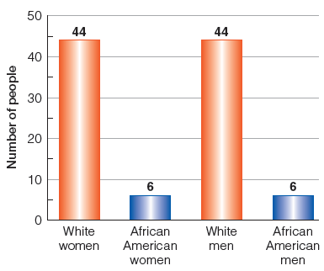
Figure 7-2
A Population of 100 Folks
Typically, sampling aims at reflecting the characteristics and dynamics of large populations. For the purpose of some simple illustrations, let’s assume our total population has only 100 members.

Slide 12
Probability Sampling
Minimizes Bias
Bias
When observations are not representative of the larger population.

Slide 13
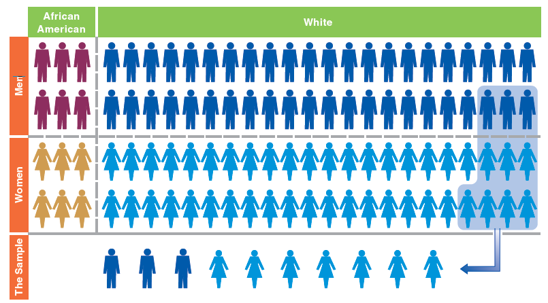
Figure 7-3
A Sample of Convenience: Easy, but Not Representative
Selecting and observing those people who are most readily at hand is the simplest method, perhaps, but it’s unlikely to provide a sample that accurately reflects the total population.

Slide 14
Probability Sampling
Better Representativeness
Representativeness
The quality of a sample of having the same distribution of characteristics as the population from which it was selected.
Samples need not be representative in all respects, only those relevant to the research.

Slide 15
Probability Sampling
A sample is representative of the population if all members of the population have an equal chance of being selected in the sample.
EPSEM (Equal Probability of Selection Method)

Slide 16
Probability Sampling
Advantages of Probability Sampling
Samples more representative because biases are avoided.
Permits estimates of the representativeness of the sample.

Slide 17
Probability Sampling
Element/Unit of Analysis
That unit of which a population is composed and which is selected in a sample
Population
The aggregation of the elements/units of analysis in a study

Slide 18
Probability Sampling
Random Selection
Each element/unit of analysis within the population has an equal chance of selection for the sample

Slide 19
Probability Sampling
Parameters and Statistics
Parameter
Summary description of a given variable in a population
Statistic
Summary description of a given variable for a sample, which is used to estimate the population parameter

Slide 20

Figure 7-4
A Population of 10 People with $0-$9
Let’s imagine a population of only 10 people with differing amounts of money in their pockets—ranging from $0-$9.

Slide 21
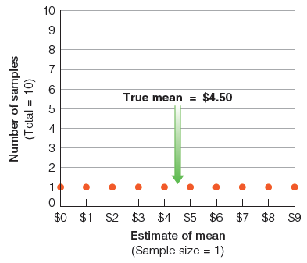
Figure 7-5
The Sampling Distribution of Samples of 1
In this simple example, the mean amount of money these people have is $4.50 ($45/10). If we picked 10 different samples of 1 person each, our “estimates” of the mean would range all across the board.

Slide 22
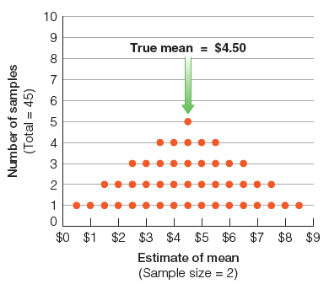
Figure 7-6
The Sampling Distribution of Samples of 2
After merely increasing our sample size to 2, the possible samples provide somewhat better estimates of the mean. We couldn’t get either $0 or $9, and the estimates are beginning to cluster around the true value of the mean: $4.50.

Slide 23
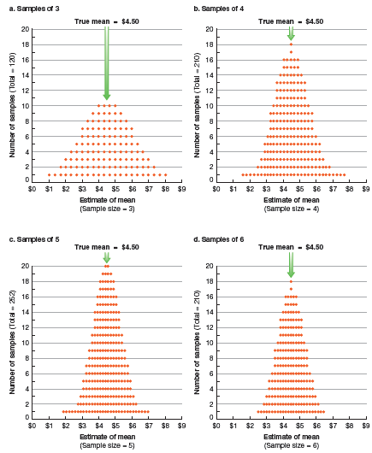
Figure 7-7
The Sampling Distributions of Samples of 3, 4, 5, and 6
As we increase the sample size, the possible samples cluster ever more tightly around the true value of the mean. The chance of extremely inaccurate estimates is reduced at the two ends of the distribution, and the percentage of the samples near the true value keeps increasing.

Slide 24
Probability Sampling
Sampling Error
the degree of error to be expected of a given sample design

Slide 25

Figure 7-8
Range of Possible Sample Study Results
Shifting to a more realistic example, let’s assume that we want to sample student attitudes concerning a proposed conduct code. Let’s assume that 50 percent disapproves—though the researcher doesn’t know that.

Slide 26
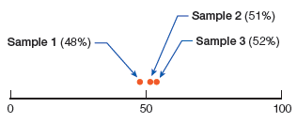
Figure 7-9
Results Produced by Three Hypothetical Studies
Assuming a large student body, let’s suppose that we selected three different samples, each of substantial size. We would not necessarily expect those samples to perfectly reflect attitudes in the whole student body, but they should come reasonably close.

Slide 27
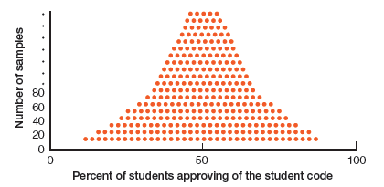
Figure 7-10
The Sampling Distribution
If we were to select a large number of good samples, we would expect them to cluster around the true value (50 percent), but given enough such samples, a few would fall far from the mark.

Slide 28
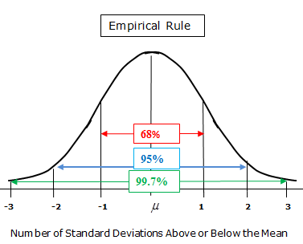
The Normal Distribution

Slide 29
Confidence: Republican Support for Trump
When asked, 40% of registered Republicans say they support Trump. The study has a margin of error (standard error) of 3 percentage points.

Slide 30
Probability Sampling
Confidence Levels and Confidence Intervals
Confidence Level
The estimated probability or how confident you are that a population parameter lies within a given confidence interval
Confidence Interval
The range of values within which a population parameter is estimated to lie.

Slide 31
Confidence, Errors, and Estimates
Assume you have a probability sample of 1000 sociology students. You asked them whether or not they were/are happy with their Sociology 101 class. Sixty-three (63) percent said “Yes.” The standard error for the question was four (4) points. What is the confidence interval for the following confidence levels:
68%
95%
99%

Slide 32
Populations and Sampling Frames
Sampling Frame
A list of units composing a population from which a sample is selected.
To be representative, sampling frame must include all members of the population.

Slide 33
Populations and Sampling Frames
Findings based on a sample represent only the aggregation of elements that compose the sampling frame.
Sampling frame omissions are inevitable.
To be generalized, all elements must have equal representation in the frame.

Slide 34
Types of Sampling Designs
Simple Random Sampling
Systematic Sampling
Stratified Sampling
Implicit Stratification in Systematic Sampling

Slide 35
Types of Sampling Designs
Simple Random Sampling
Units are assigned numbers. A set of random numbers is generated and the units having those numbers are included in the sample.
Not necessarily the most accurate sampling method.

Slide 36
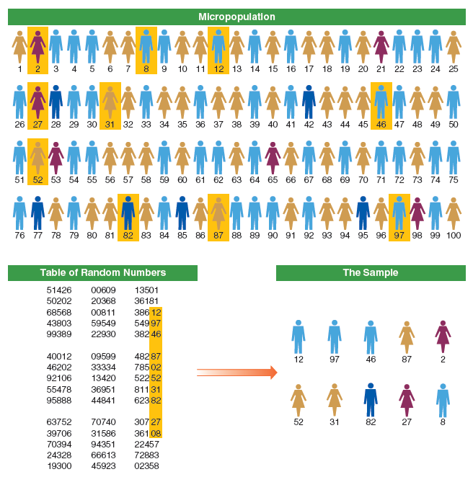
Figure 7-11
A Simple Random Sample
Having numbered everyone in the population, we can use a table of random numbers to select a representative sample from the overall population. Anyone whose number is chosen from the table is in the sample.

Slide 37
Types of Sampling Designs
Systematic Sampling
Every kth unit in a list is selected for inclusion in the sample.
Slightly more accurate than simple random sampling.

Slide 38
Types of Sampling Designs
Stratified Sampling
Stratification
Grouping units of a population into homogenous groups (strata) before sampling.
Slightly more accurate than simple random sampling.
Stratification is a modification to simple random and systematic sampllin methods.

Slide 39
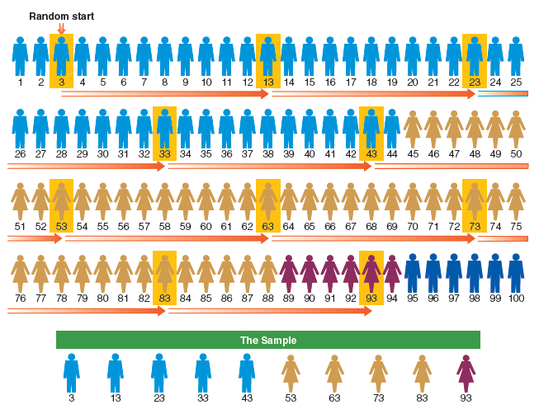
Figure 7-12
A Stratified, Systematic Sample with a Random Start
A stratified, systematic sample involves two stages. First the members of the population are gathered into homogeneous strata; this simple example merely uses gender and race as stratification variables, but more could be used. Then every kth (in this case, every tenth) person in the stratified arrangement is selected into the sample.

Slide 40
Types of Sampling Designs
Implicit Stratification in Systematic Sampling
Sampling Students at University of Hawaii
Sampling Modification

Slide 41
Probability Sampling in Review
Remains the most effective method for selection of study elements because:
Allows researchers to avoid biases in element selection
Permits estimates of error

